Slide 1
Chapter 5:
Algorithms
Computer Science: An Overview
Eleventh Edition
by
J. Glenn Brookshear
Dennis Brylow

Slide 2
Chapter 5: Algorithms
5.1 The Concept of an Algorithm
5.2 Algorithm Representation
5.3 Algorithm Discovery
5.4 Iterative Structures
5.5 Recursive Structures
5.6 Efficiency and Correctness

Slide 3
Definition of Algorithm
An algorithm is an ordered set of unambiguous, executable steps that defines a terminating process.

Slide 4
Algorithm Representation
Requires well-defined primitives
A collection of primitives constitutes a programming language.

Slide 5
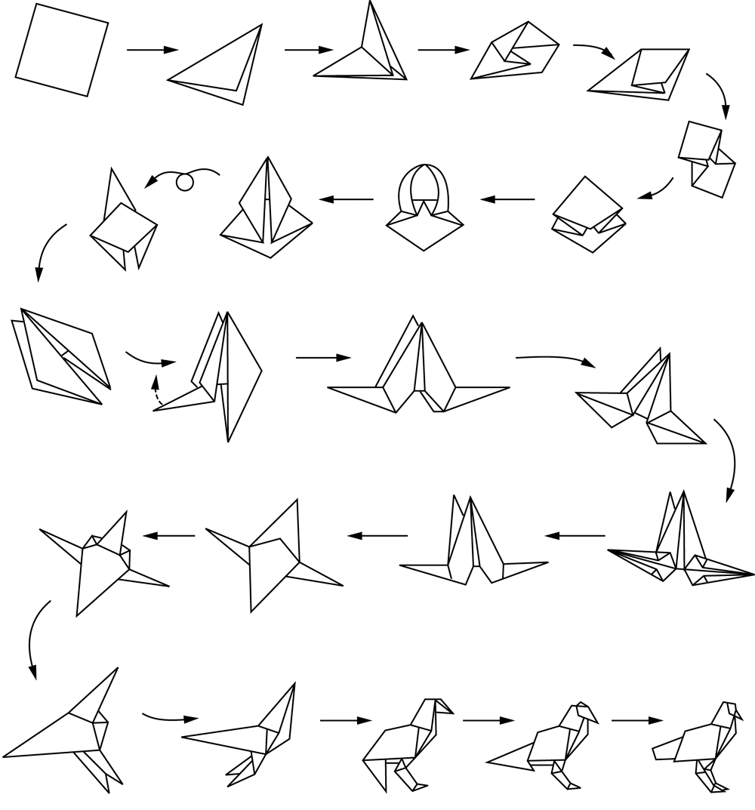
Figure 5.2 Folding a bird from a square piece of paper

Slide 6
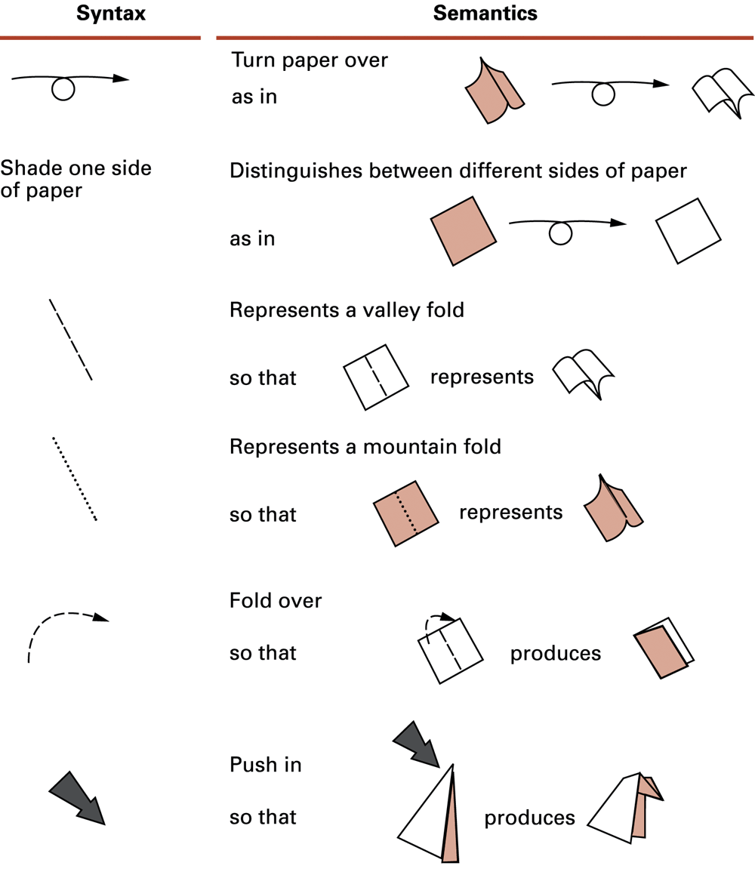
Figure 5.3 Origami primitives

Slide 7
Pseudocode Primitives
Assignment
name = expression
Example
RemainingFunds = CheckingBalance +
SavingsBalance

Slide 8
Pseudocode Primitives (continued)
Conditional selection
if (condition):
activity
Example
if (sales have decreased):
lower the price by 5%

Slide 9
Pseudocode Primitives (continued)
Conditional selection
if (condition):
activity
else:
activity
Example
if (year is leap year):
daily total = total / 366
else:
daily total = total / 365

Slide 10
Pseudocode Primitives (continued)
Repeated execution
while (condition):
body
Example
while (tickets remain to be sold):
sell a ticket

Slide 11
Pseudocode Primitives (continued)
Indentation shows nested conditions
if (not raining):
if (temperature == hot):
go swimming
else:
play golf
else:
watch television

Slide 12
Pseudocode Primitives (continued)
Define a function
def name():
Example
def ProcessLoan():
Executing a function
if (. . .):
ProcessLoan()
else:
RejectApplication()

Slide 13
Figure 5.4 The procedure Greetings in pseudocode
def Greetings():
Count = 3
while (Count > 0):
print('Hello')
Count = Count - 1

Slide 14
Pseudocode Primitives (continued)
Using parameters
def Sort(List):
.
.
Executing Sort on different lists
Sort(the membership list)
Sort(the wedding guest list)

Slide 15
Polya’s Problem Solving Steps
1. Understand the problem.
2. Devise a plan for solving the problem.
3. Carry out the plan.
4. Evaluate the solution for accuracy and its potential as a tool for solving other problems.

Slide 16
Polya’s Steps in the Context of Program Development
1. Understand the problem.
2. Get an idea of how an algorithmic function might solve the problem.
3. Formulate the algorithm and represent it as a program.
4. Evaluate the solution for accuracy and its potential as a tool for solving other problems.

Slide 17
Getting a Foot in the Door
Try working the problem backwards
Solve an easier related problem
  Relax some of the problem constraints
  Solve pieces of the problem first (bottom up methodology)
Stepwise refinement: Divide the problem into smaller problems (top-down methodology)

Slide 18
Ages of Children Problem
Person A is charged with the task of determining the ages of B’s three children.
  B tells A that the product of the children’s ages is 36.
  A replies that another clue is required.
  B tells A the sum of the children’s ages.
  A replies that another clue is needed.
  B tells A that the oldest child plays the piano.
  A tells B the ages of the three children.
How old are the three children?

Slide 19
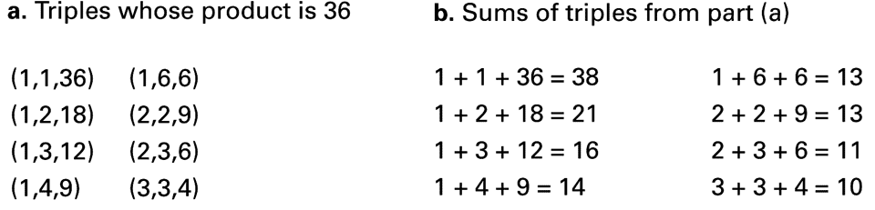
Figure 5.5

Slide 20
Figure 5.6 The sequential search algorithm in pseudocode
def Search (List, TargetValue):
if (List is empty):
Declare search a failure
else:
Select the first entry in List to be TestEntry
while (TargetValue > TestEntry and entries remain):
Select the next entry in List as TestEntry
if (TargetValue == TestEntry):
Declare search a success
else:
Declare search a failure

Slide 21
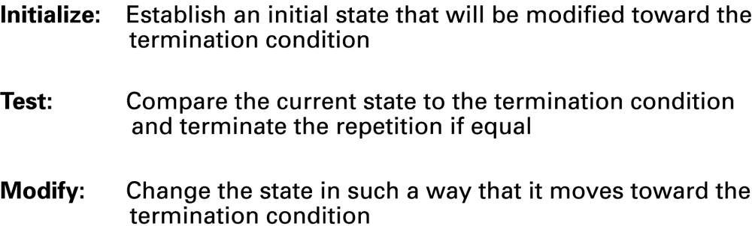
Figure 5.7 Components of repetitive control

Slide 22
Iterative Structures
Pretest loop:
while (condition):
body
Posttest loop:
repeat:
body
until(condition)

Slide 23
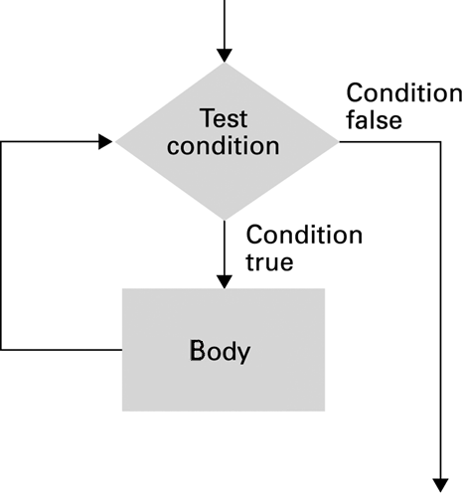
Figure 5.8 The while loop structure

Slide 24
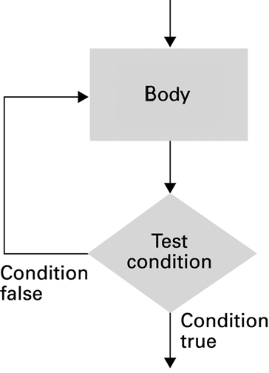
Figure 5.9 The repeat loop structure

Slide 25
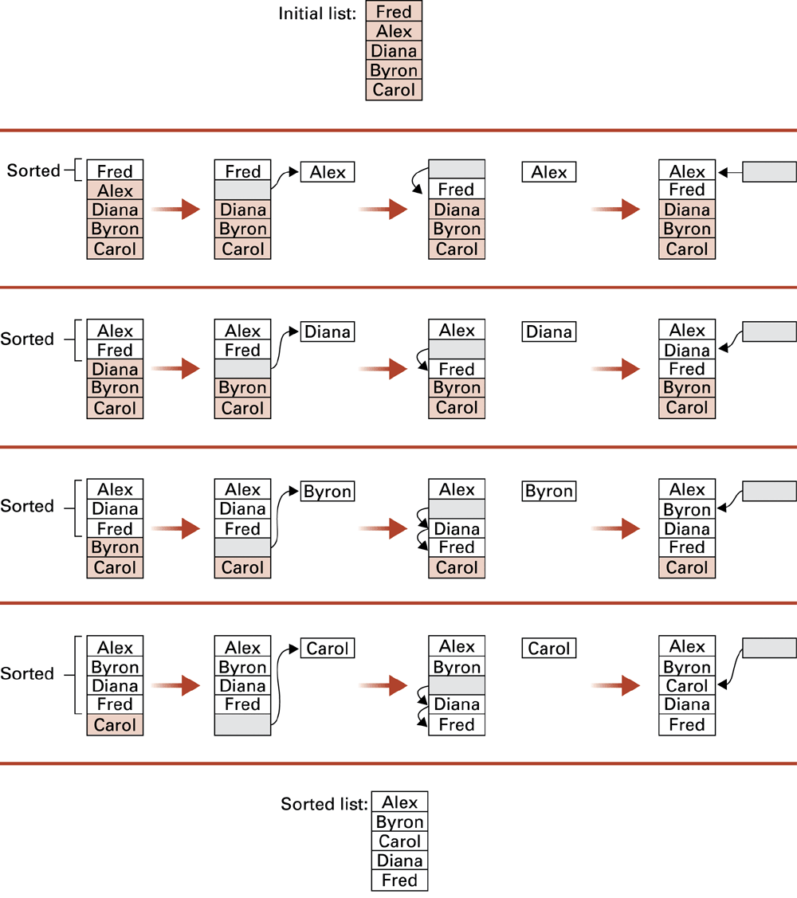
Figure 5.10 Sorting the list Fred, Alex, Diana, Byron, and Carol alphabetically

Slide 26
Figure 5.11 The insertion sort algorithm expressed in pseudocode
def Sort(List):
N = 2
while (N <= length of List):
Pivot = Nth entry in List
Remove Nth entry leaving a hole in List
while (there is an Entry above the
hole and Entry > Pivot):
Move Entry down into the hole leaving
a hole in the list above the Entry
Move Pivot into the hole
N = N + 1

Slide 27
Recursion
The execution of a procedure leads to another execution of the procedure.
Multiple activations of the procedure are formed, all but one of which are waiting for other activations to complete.

Slide 28
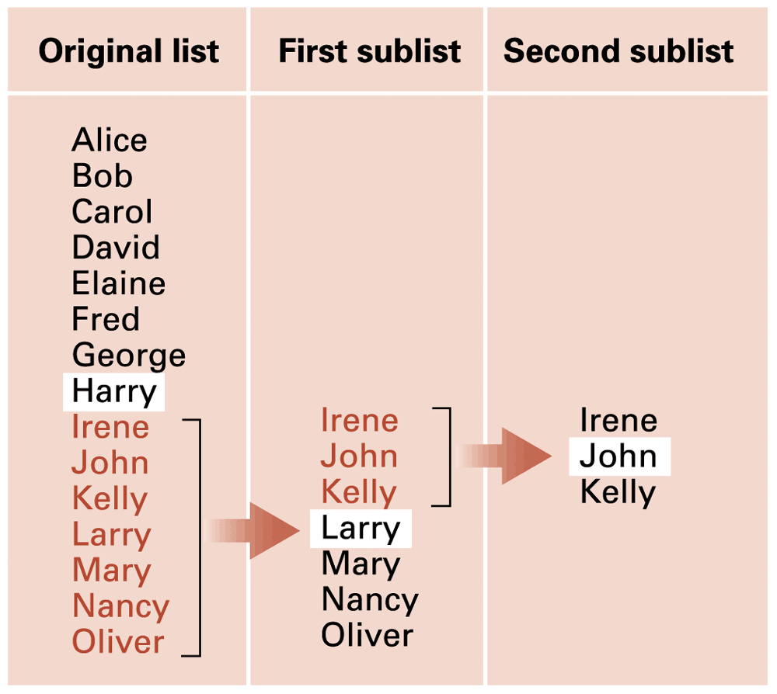
Figure 5.12 Applying our strategy to search a list for the entry John

Slide 29
Figure 5.13 A first draft of the binary search technique
if (List is empty):
Report that the search failed
else:
TestEntry = middle entry in the List
if (TargetValue == TestEntry):
Report that the search succeeded
if (TargetValue < TestEntry):
Search the portion of List preceding TestEntry for
TargetValue, and report the result of that search
if (TargetValue > TestEntry):
Search the portion of List following TestEntry for
TargetValue, and report the result of that search

Slide 30
Figure 5.14 The binary search algorithm in pseudocode
def Search(List, TargetValue):
if (List is empty):
Report that the search failed
else:
TestEntry = middle entry in the List
if (TargetValue == TestEntry):
Report that the search succeeded
elif (TargetValue < TestEntry):
Sublist = portion of List preceding TestEntry
Search(Sublist, TargetValue)
else (TargetValue > TestEntry):
Sublist = portion of List following TestEntry
Search(Sublist, TargetValue)

Slide 31
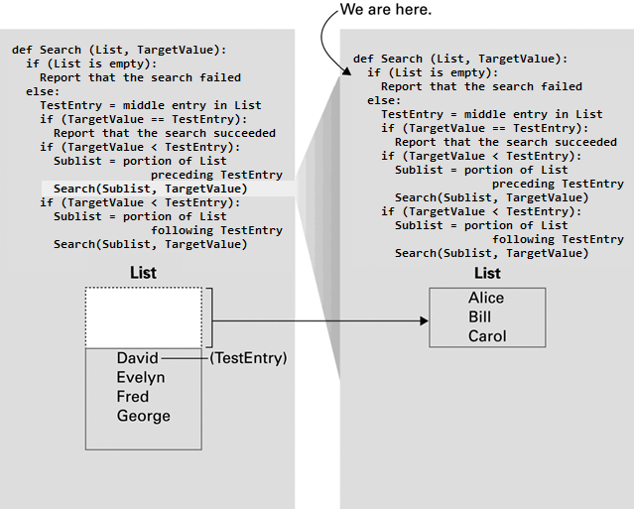
Figure 5.15

Slide 32
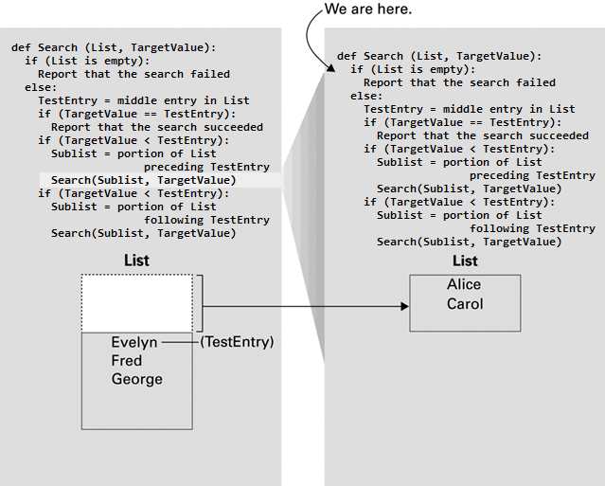
Figure 5.16

Slide 33
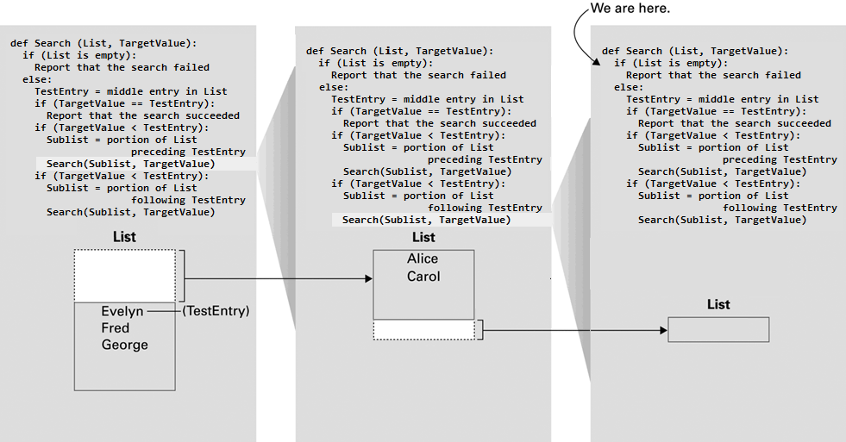
Figure 5.17

Slide 34
Algorithm Efficiency
Measured as number of instructions executed
Big theta notation: Used to represent efficiency classes
  Example: Insertion sort is in Θ(n²)
Best, worst, and average case analysis

Slide 35
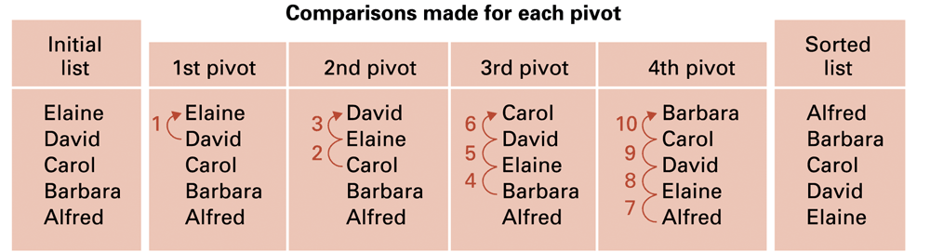
Figure 5.18 Applying the insertion sort in a worst-case situation

Slide 36
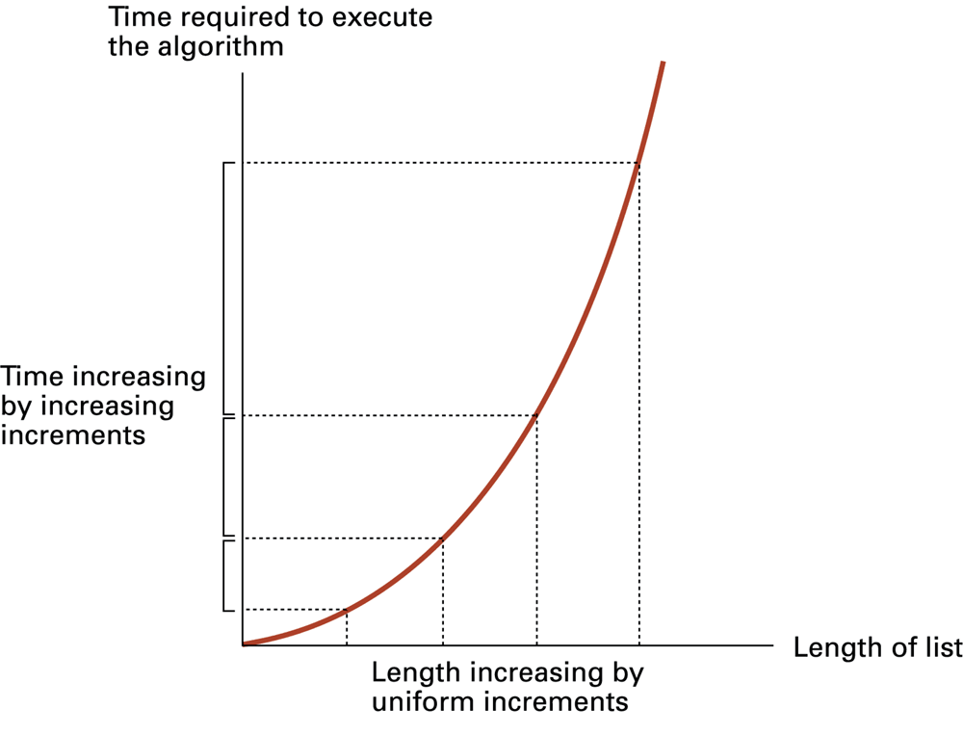
Figure 5.19 Graph of the worst-case analysis of the insertion sort algorithm

Slide 37
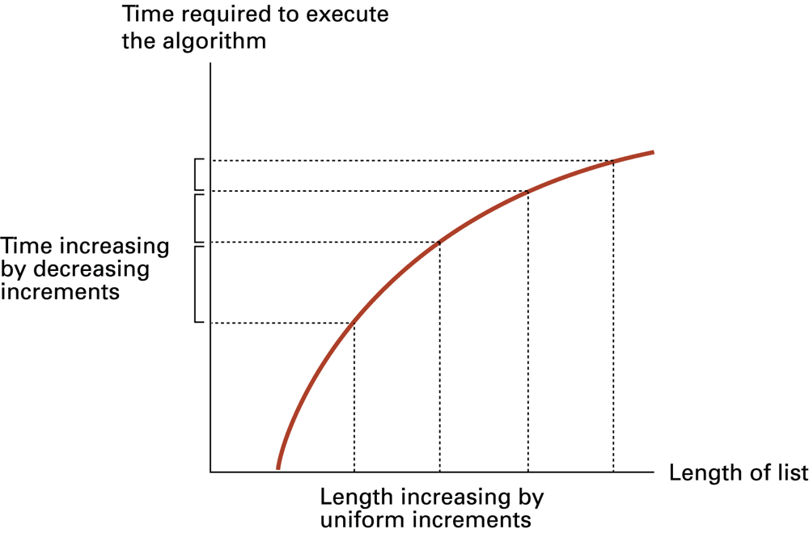
Figure 5.20 Graph of the worst-case analysis of the binary search algorithm

Slide 38
Software Verification
Proof of correctness
  Assertions
    Preconditions
    Loop invariants
Testing

Slide 39
Chain Separating Problem
A traveler has a gold chain of seven links.
He must stay at an isolated hotel for seven nights.
The rent each night consists of one link from the chain.
What is the fewest number of links that must be cut so that the traveler can pay the hotel one link of the chain each morning without paying for lodging in advance?

Slide 40
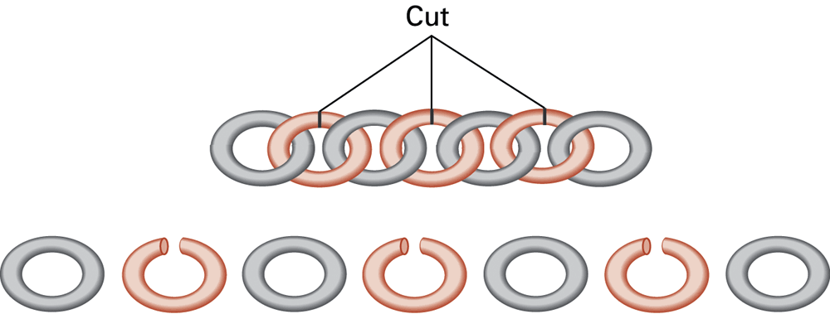
Figure 5.21 Separating the chain using only three cuts

Slide 41
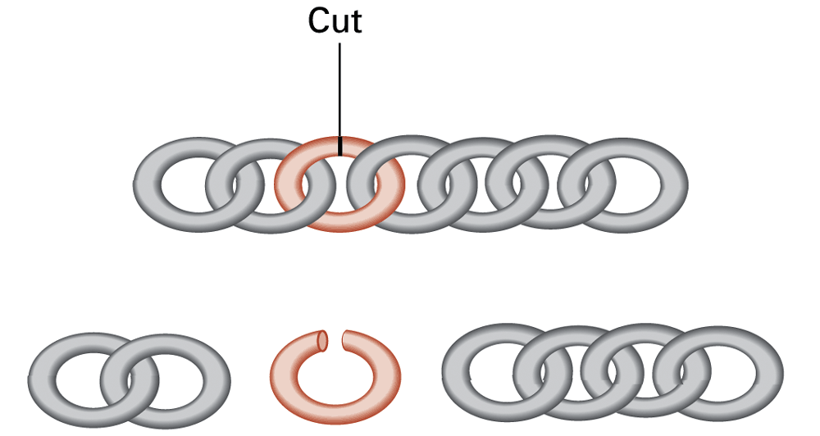
Figure 5.22 Solving the problem with only one cut

Slide 42
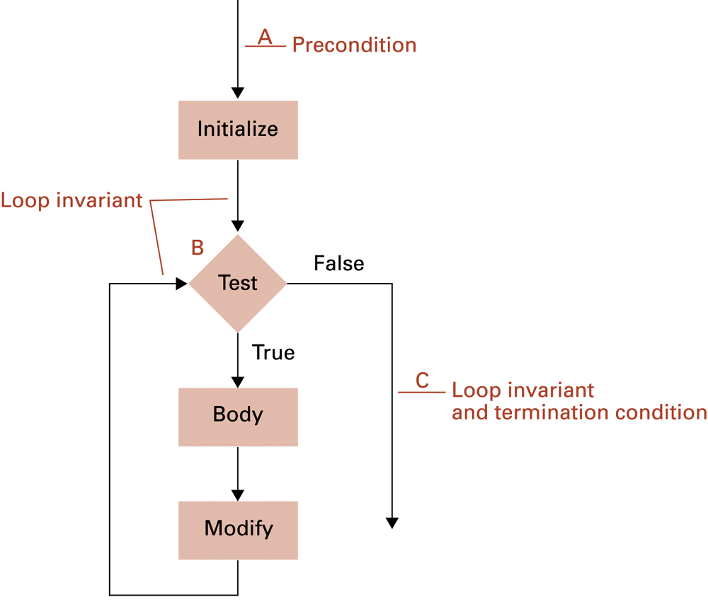
Figure 5.23 The assertions associated with a typical while structure

